Slide 1
Joining & Merging Data
Jeremy Bergmann - Omaha Data Science Academy

Slide 2
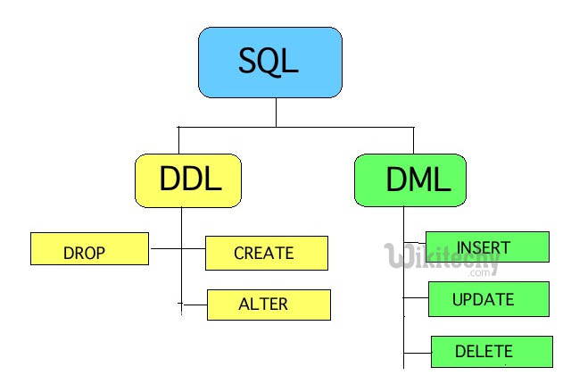
Class 3 Review – Data Storage
Data Storage
Create and delete databases
Create and delete tables
Create tables with constraints
Add and delete table fields
Add and delete table constraints
Insert data manually into tables
Import data from SQL and CSV files
Notes:
Feynman technique: Learn -> Explain -> Reflect -> Repeat
What are the most important ideas from last class? Write a summary of the information as if explaining to a 14 year old. Avoid jargon Keep the words and sentences simple Rely on memory Make the explanation visual, if possible Note where you had difficulty or have knowledge gaps. These indicate things you should review, research, or ask questions about

Slide 3
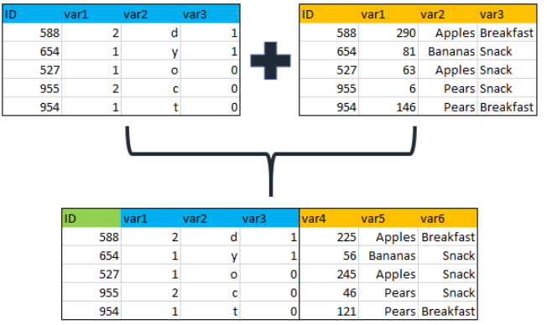
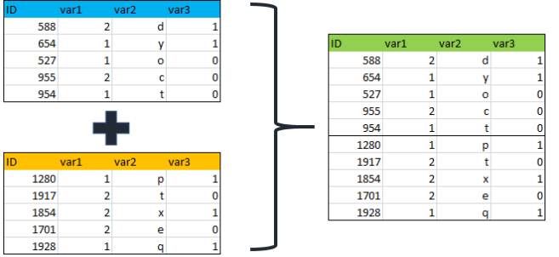
Class 4 Objectives
Joining & Merging Data
Joining Data - inner, outer and left Merging/Appending Data – Union/Union All
Notes:
Feynman technique: Learn -> Explain -> Reflect -> Repeat
What are the most important ideas from last class? Write a summary of the information as if explaining to a 14 year old. Avoid jargon Keep the words and sentences simple Rely on memory Make the explanation visual, if possible Note where you had difficulty or have knowledge gaps. These indicate things you should review, research, or ask questions about

Slide 4
What is the need for data manipulation?
Creating new datasets & Combine disparate data sets
Perform common queries, aggregations, and joins
Adding, removing, or modifying data
Extracting and Storing Data
Creation/Extraction
Transforming data
Cleaning data
Storage & Retrieval
Notes:
Creation: creating tables and databases, the things
Storage: where data are stored
Cleaning: adding, removing, or modifying data
Retrieval: selecting only the data you want

Slide 5
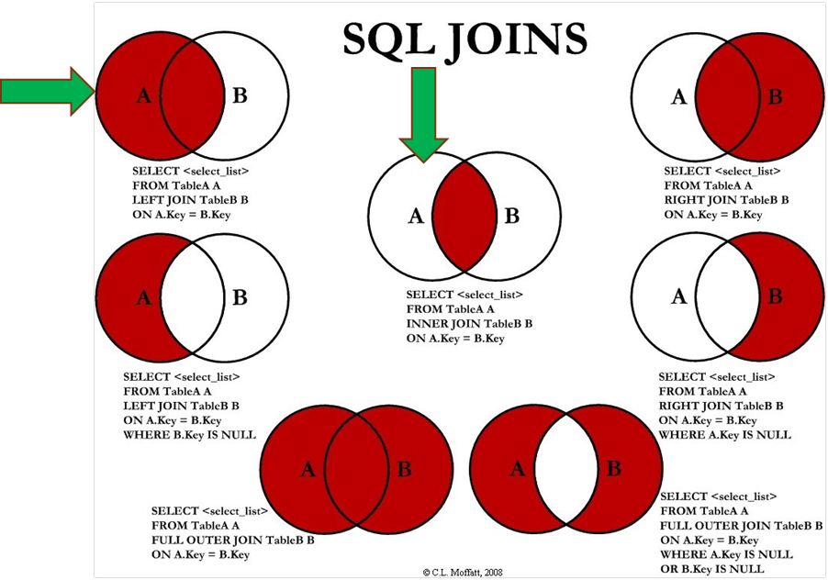
How do you combine data?
Answer:
SQL Joins can be done using WHERE or JOIN clauses!
Notes:
Most Common - INNER & LEFT, Sometimes Full Outer

Slide 6
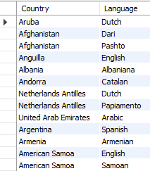
Inner Join - Example
Syntax SELECT <columns> FROM <table> AS <alias> <join type> JOIN <table> AS <alias>
ON <table alias>.<table column> = <table alias2>.<column>
Example - Official Languages SELECT a.Name as Country, b.Language FROM world.country as a INNER JOIN world.countrylanguage as b ON a.code = b.countryCode and b.IsOfficial ='T'

Slide 7
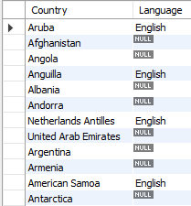
Left Join - Example
Question: “Which countries do/do not speak English as a language?”
Example
SELECT a.Name as Country, b.Language FROM world.country as a LEFT JOIN world.countrylanguage as b ON a.code = b.countryCode and b.`Language` ='English'
Notes:
Security: databases have additional security measures
Data integrity: data changes require intent
Customization: you can organize it best on your needs
Recovery: you don’t lose the data if there’s a catastrophic error
Learning curve: you have to learn how to manipulate it
Abstract: a less visual representation and demands more from the user

Slide 8
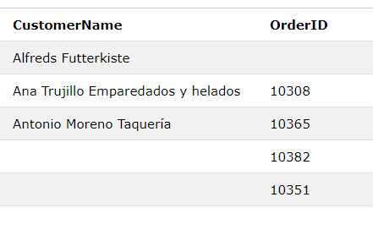
Full Outer Join - Example
Question: “List all Customer and Order Name, regardless of a customer placing an order, or an order without a customer name”
Example
SELECT a.CustomerName, b.OrderID FROM Customers as a FULL OUTER JOIN Orders b ON a.CustomerID=b.CustomerID ORDER BY a.CustomerName;

Slide 9
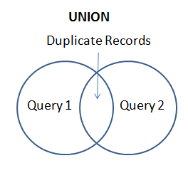
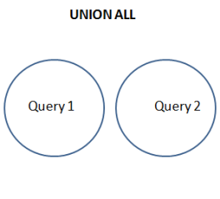
SQL Union & Union All
Purpose: The UNION operator is used to combine the result-set of two or more SELECT statements.
Each SELECT statement within UNION must have the same number of columns
The columns must also have similar data types
The columns in each SELECT statement must also be in the same order

Slide 10
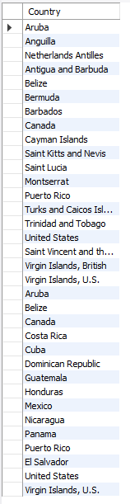
SQL Union All
Example
SELECT a.Name as Country FROM world.country as a Inner JOIN world.countrylanguage as b ON a.code = b.countryCode and b.`Language` ='English' Where a.Continent = 'North America' Union All SELECT a.Name as Country FROM world.country as a Inner JOIN world.countrylanguage as b ON a.code = b.countryCode and b.`Language`='Spanish' Where a.Continent = 'North America'
Question: “List all countries in North America that speak English or Spanish as a language, with duplication.
/

Slide 11
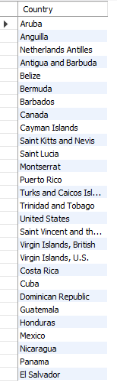
SQL Union
Question:
“List all countries in North America that speak English or Spanish as a language, with no duplication.
Example
SELECT a.Name as Country FROM world.country as a Inner JOIN world.countrylanguage as b ON a.code = b.countryCode and b.`Language` ='English' Where a.Continent = 'North America' Union SELECT a.Name as Country FROM world.country as a Inner JOIN world.countrylanguage as b ON a.code = b.countryCode and b.`Language`='Spanish' Where a.Continent = 'North America'

Slide 12
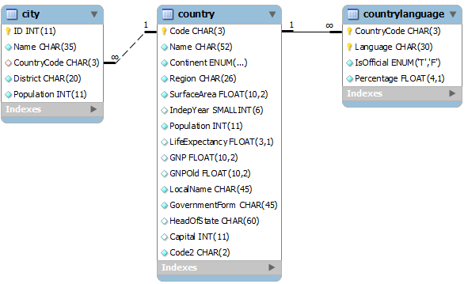
Exercises
SQL Joins & Unions
1. Using a union on the world.country table, combine all countries (repeating) with a life expectancy of > 80 years or a GNP > 1000000, with no repeats.
2. List all official languages spoken in the 'Southeast Asia' region.
3. List all the countries in North America, then match (left join) the “percentage” of the population that speaks English.
4. In the “world” schema, obtain the name of all cities in North America that have a population over 1M, where the primary language is English or Spanish (with repeats).
Notes:
Schema: https://gist.github.com/mdang/9a4a8063ebea3b829b8025746643ade1

